Slide 1
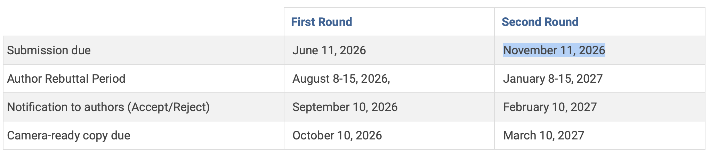
Submission Plan
ICDE deadlines:
We should not submit to VLDB, because the notification date will be Nov 15th if we submit to Oct 1 cycle

Slide 2
CTCP vs CF-CTCP
CTCP: optimized method used in kPlexT
bad-CTCP: bad implementation of CTCP by kPEX
kPEX introduced CF-CTCP and, in its ablation study, reported that CF-CTCP outperformed its own implementation of CTCP (called bad-CTCP). However, a closer inspection shows that the CTCP baseline used there was comparatively weak.
Issues to bad-CTCP
Expensive triangle counting
  Both kPlexT and kPEX precomputes triangle counts of edges
  bad-CTCP does not use degeneracy-oriented graph when computing initial triangle counts of edges, so intersections are more expensive due to long adjacency lists of high-degree vertices
  bad-CTCP does not use N+() to count each triangle only once, but count 3 times.

Slide 3
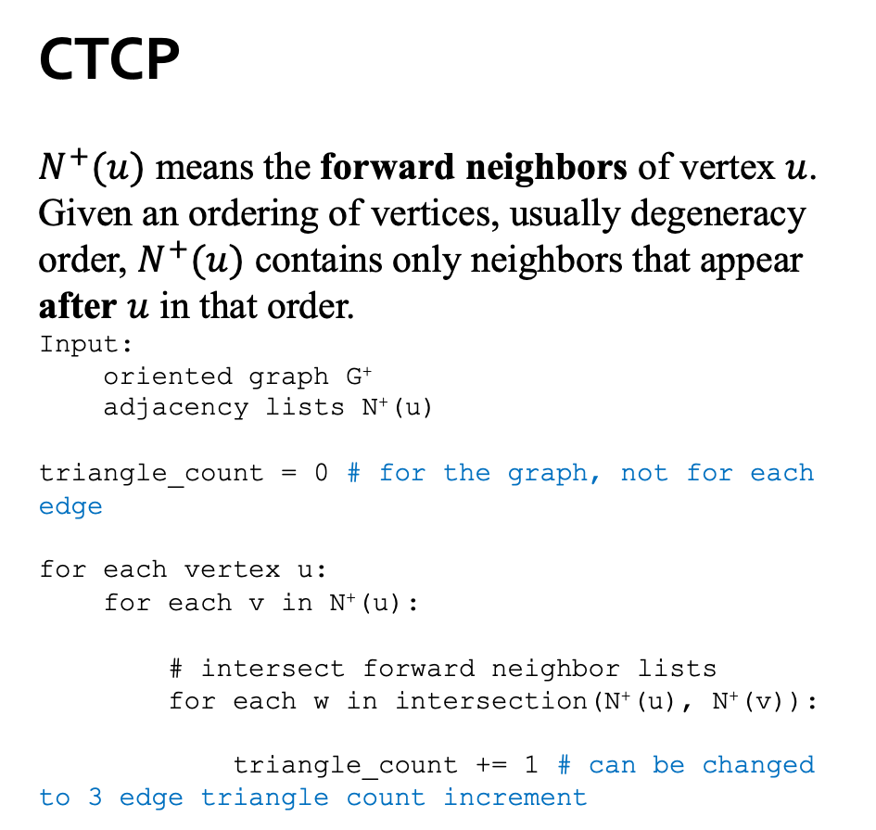
Triangle Counting
CTCP
$N^{+}(u)$ means the forward neighbors of vertex $u$.
Given an ordering of vertices, usually degeneracy order, $N^{+}(u)$ contains only neighbors that appear after $u$ in that order.
Input:
oriented graph G⁺
adjacency lists N⁺(u)
triangle_count = 0 # for the graph, not for each edge
for each vertex u:
for each v in N⁺(u):
# intersect forward neighbor lists
for each w in intersection(N⁺(u), N⁺(v)):
triangle_count += 1 # can be changed to 3 edge triangle count increment
The graph is recoded with degeneracy order
CF-CTCP
For each edge u->v (where v<u) count number of triangles.
bad-CTCP
For each edge u->v count number of triangles.
still not bounded by degeneracy!

Slide 4
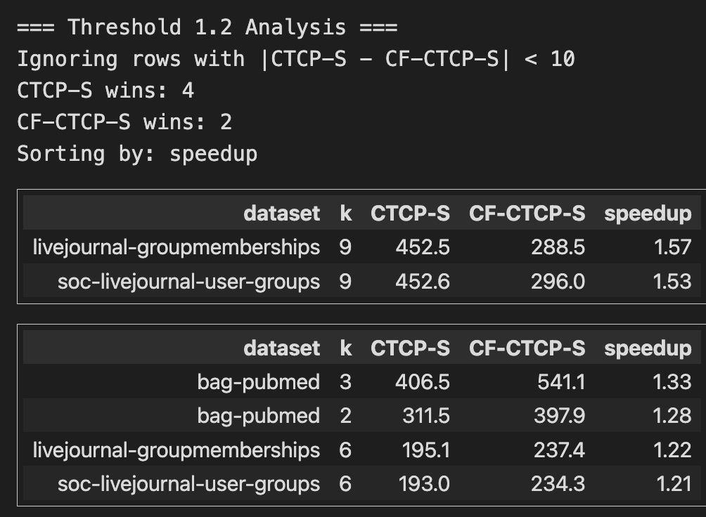
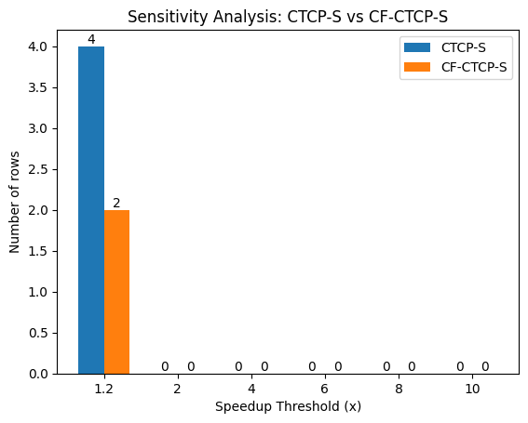
Improved CF-CTCP
Implemented efficient triangle counting in CF-CTCP
The performance stays very close to CTCP

Slide 5
Reverse Edges
CF-CTCP and CTCP uses a reverse edge to quickly remove the reverse edge
For example, if: (edge_to is vertex array in CSR)
  edge_to[i] = v represents u -> v
  edge_to[j] = u represents v -> u
then the initialization records:
  reverse_edge[i] = j;
  reverse_edge[j] = i;
For an edge u->v at index i, use binary_search on v’s adjacency list to find index j.
Another array is used to track which edges are removed (edge_removed_from_G)
u’s neighbors
v’s neighbors
edge_to
v
u
i
j
m
reverse_edge
j
i
i
j
m

Slide 6
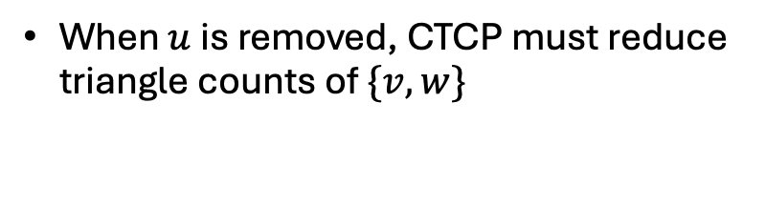
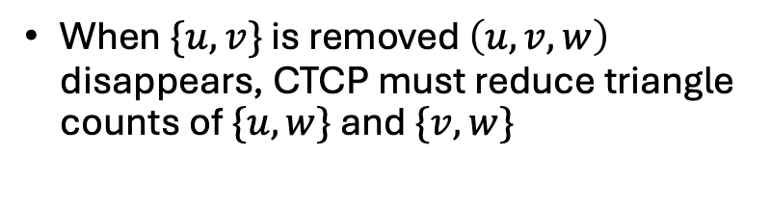
Benefit of reverse_edge
When $\{u,v\}$ is removed $\left(u,v,w\right)$ disappears, CTCP must reduce triangle counts of $\{u,w\}$ and $\{v,w\}$
When $u$ is removed, CTCP must reduce triangle counts of $\{v,w\}$
u
v
u
v
w
w
u->w edge information is found from u’s adjacency,
lookup reverse_edge for w->u edge, and update its triangle count
reverse_edge
j
i
i
j
m
triangle_counts
m

Slide 7
CTCP vs CF-CTCP
Expensive reverse edge lookup (Issue unique to bad CTCP)
Each undirected edge has two entries: u → v and v → u.
CTCP must update both when deleting {u,v}.
Binary search for the reverse entry adds repeated overhead (bad-CTCP).
A reverse pointer gives O(1) access to it (used in CTCP, CF-CTCP).
  what is the benefit of populating reverse_edge initially? given that it has to do binary search for all edges.

Slide 8
CTCP vs CF-CTCP
Released bad-CTCP scan adjacency lists (with binary search) to find reverse edges.
CF-CTCP and CTCP use reverse-edge mappings for O(1) lookup.
CF-CTCP’s advantage may partly come from this implementation difference.
CF-CTCP counts the triangles with condition v<u, i.e. bounded by maximum degree rather than by graph degeneracy. This may cause it to be very slow in some cases.

Slide 9
Representative instances
dataset | k | CTCP | CF-CTCP | speedup
sx-stackoverflow | 7 | 168.2 | OOT | 10.7
wikipedia-link-en13 | 7 | 105.1 | 986.3 | 9.39
web-wikipedia_link_en13-all | 7 | 103.1 | 721.9 | 7.01
wikipedia_link_sr | 2 | 243.2 | 645 | 2.65
bag-pubmed | 2 | 680.6 | OOT | 2.64
CTCP wins
dataset | k | CTCP | CF-CTCP | speedup
soc-orkut | 20 | 21.1 | 8.5 | 2.48
nd3k | 20 | 62.6 | 31.1 | 2.01
soc-orkut | 15 | 31.1 | 17.7 | 1.75
dbpedia-link | 5 | 37 | 22.4 | 1.65
web-wikipedia_link_fr | 3 | 30.6 | 18.6 | 1.65
CF-CTCP wins
note: time is short
show CTCP is better in majority of cases, e.g. show a histogram, distribution of speedup ratio

Slide 10
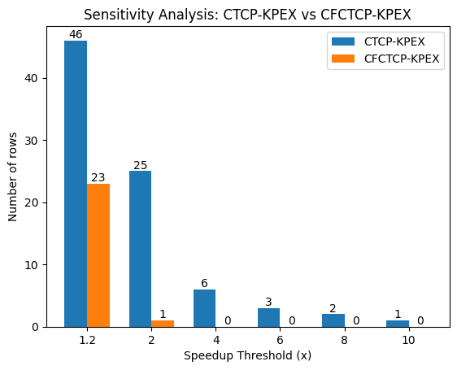
CTCP

Slide 11

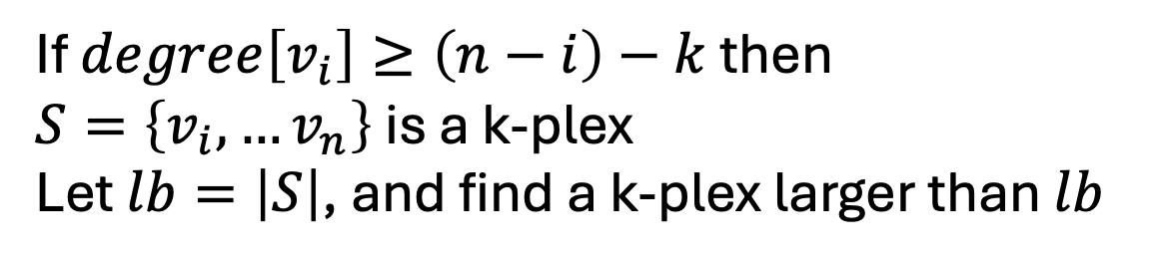
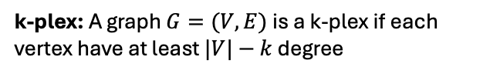

Finding an initial k-plex
k-plex: A graph $G=(V, E)$is a k-plex if each vertex have at least $|V|−k$ degree
Degeneracy Order
$$i$$
$$n$$
If $degree\left[v_{i}\right]≥\left(n−i\right)−k$ then
$S=\left\{v_{i},…v_{n}\right\}$ is a k-plex
Let $lb=\left|S\right|$, and find a k-plex larger than $lb$

Slide 12
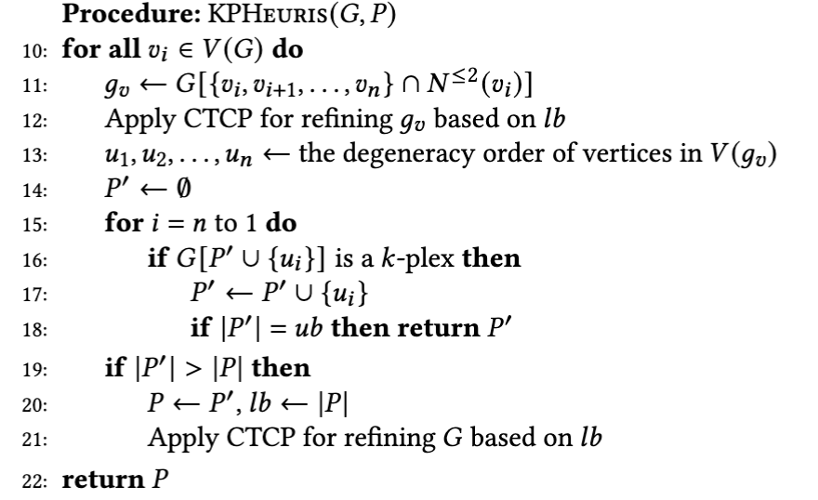
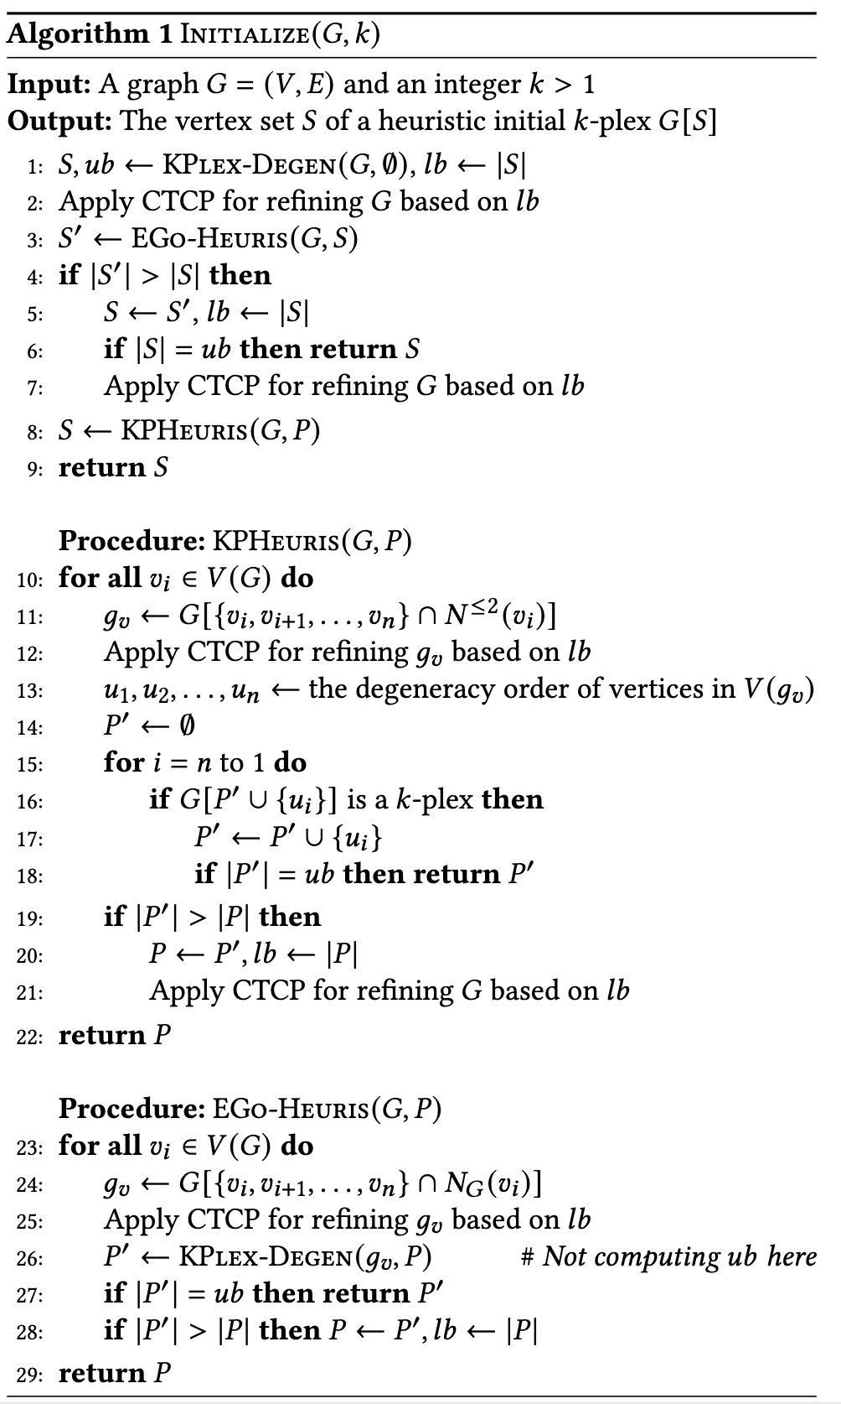
Heuristic Method KPHeur vs kPEX-EGo
kPEX compares KPHeuris with a basic EGo-Degen variant, kPEX-EGo.
kPEX-EGo is less optimized than kPlexT’s EGo-Degen variant, denoted EGo-opt.
lb=|P|

Slide 13
Heuristic Method KPHeur vs kPEX-EGo
kPlexT’s EGo-opt is faster than (intentionally poor baseline) kPEX’s EGo (hence replaced) for two main reasons.
EGo-opt is more memory-efficient.
  EGo-opt reuses preallocated array-based buffers (CSR) across root (top-level) vertices. No repeated new/delete
  kPEX-EGo rebuilds fresh vector<ui> and vector<vector<ui>> structures for every root vertex. See Line 24
  This repeated vector construction, reallocation, destruction increases memory-management overhead.

Slide 14
Heuristic Method KPHeur vs kPEX-EGo
kPlexT’s EGo-opt is faster than (intentionally poor baseline) kPEX’s EGo (hence replaced) for two main reasons.
EGo-opt performs stronger early pruning.
  EGo-opt applies a threshold-based pruning step before degeneracy peeling.
  This removes vertices that cannot contribute to a better k-plex early.
  So the later peeling step runs on a smaller local subgraph.
  kPEX-EGo instead builds the full ego subgraph first and only then applies peeling (i.e., Degen), which leads to more unnecessary work. (Line 25 is not implemented)

Slide 15
Heuristic Method KPHeur vs kPEX-EGo
EGo-opt is faster because it avoids repeated vector-based subgraph construction and reduces the local search space earlier.
Its runtime is usually negligible compared with KPHeuris.
KPHeuris is more expensive, but can sometimes find a larger initial k-plex.
Running EGo-opt first produces an initial lower bound quickly.
This stronger bound can reduce the subsequent search effort of KPHeuris.

Slide 16
Proposed Initialization
Algo code is in notes of this slide
Notes:
\begin{algorithm}[t]
\caption{\textsc{Initialize}$(G,k)$}
\begin{flushleft}
\textbf{Input:} A graph $G=(V,E)$ and an integer $k>1$\\
\textbf{Output:} The vertex set $S$ of a heuristic initial $k$-plex $G[S]$
\end{flushleft}
\begin{algorithmic}[1]
\State $S, ub \gets \textsc{KPlex-Degen}(G,\emptyset)$, $lb \gets |S|$
\State Apply CTCP for refining $G$ based on $lb$
\State $S' \gets \textsc{EGo-Heuris}(G,S)$
\If{$|S'| > |S|$}
\State $S \gets S'$, $lb \gets |S|$
\State \textbf{if} $|S|=ub$ \textbf{then return} $S$
\State Apply CTCP for refining $G$ based on $lb$
\EndIf
\State $S \gets \textsc{KPHeuris}(G,P)$
\State \Return $S$
\Statex
\Statex \textbf{Procedure:} \textsc{KPHeuris}$(G,P)$
\ForAll{$v_i \in V(G)$}
\State $g_v \gets G[\{v_i,v_{i+1},\ldots,v_n\}\cap N^{\leq 2}(v_i)]$
\State Apply CTCP for refining $g_v$ based on $lb$
\State $u_1,u_2,\ldots,u_n \gets$ the degeneracy order of vertices in $V(g_v)$
\State $P' \gets \emptyset$
\For{$i=n$ to $1$}
\If{$G[P'\cup\{u_i\}]$ is a $k$-plex}
\State $P' \gets P' \cup \{u_i\}$
\State \textbf{if} $|P'|=ub$ \textbf{then return} $P'$
\EndIf
\EndFor
\If{$|P'| > |P|$}
\State $P \gets P', lb \gets |P|$
\State Apply CTCP for refining $G$ based on $lb$
\EndIf
\EndFor
\State \Return $P$
\Statex
\Statex \textbf{Procedure:} \textsc{EGo-Heuris}$(G,P)$
\ForAll{$v_i \in V(G)$}
\State $g_v \gets G[\{v_i, v_{i+1}, \ldots, v_n\} \cap N_G(v_i)]$
\State Apply CTCP for refining $g_v$ based on $lb$
\State $P' \gets \textsc{KPlex-Degen}(g_v, P)$ \hfill \# \textit{Not computing $ub$ here}
\State \textbf{if} $|P'|=ub$ \textbf{then return} $P'$
\State \textbf{if} $|P'| > |P|$ \textbf{then} $P \gets P', lb \gets |P|$
\EndFor
\State \Return $P$
\end{algorithmic}
\end{algorithm}

Slide 17
Representative Instances
times are total execution time
dataset | k | KPHeur | EGo-opt | speedup
web-wikipedia_link_en13-a... | 20 | OOT | 82.9 | 21.71
wikipedia-link-en13 | 20 | OOT | 89.3 | 20.15
web-wikipedia_link_en13-a... | 10 | OOT | 90.3 | 19.94
TSOPF_FS_b39_c19 | 10 | 51.7 | 3.8 | 13.68
TSOPF_FS_b39_c30 | 10 | 112.4 | 8.7 | 12.94
lkml-reply | 9 | 583.4 | 47.4 | 12.31
EGo-opt wins
dataset | k | KPHeur | EGo-opt | speedup
webbase-1M | 10 | 0.1 | 866.3 | 11597.67
TSOPF_RS_b162_c3 | 8 | 0.3 | 1800 | 6550.22
Maragal_7 | 7 | 0.3 | 1800 | 5630.28
TSOPF_RS_b162_c1 | 20 | 0.4 | 1800 | 4547.75
TSOPF_RS_b162_c4 | 8 | 0.4 | 1800 | 4020.55
TSOPF_RS_b162_c3 | 20 | 0.9 | 1800 | 2032.98
KPHeur wins

Slide 18
Representative Instances
dataset | k | KPHeur | Proposed | speedup
wikipedia_link_sr | 9 | 610.3 | 19.1 | 32.02
wikipedia-link-en13 | 15 | OOT | 81.7 | 22.03
web-wikipedia_link_en13-all | 20 | OOT | 85.3 | 21.11
lkml-reply | 9 | 527 | 47.4 | 11.12
sx-stackoverflow | 7 | OOT | 190.7 | 9.44
Proposed wins
dataset | k | KPHeur | Proposed | speedup
jester2 | 6 | 0.2 | 1.8 | 10.9
ship_003 | 10 | 0.2 | 1.4 | 9.08
soc-FourSquare | 9 | 0.2 | 1.4 | 6.63
af_shell8 | 4 | 1.9 | 11.9 | 6.39
pdb1HYS | 4 | 0.4 | 1.9 | 5.19
KPHeur wins
Proposed: EGo-opt followed by KPHeur

Slide 19
Top 2 rows of every algorithm
dataset | k | n | m | d_avg | d_max | best_algo | best_time | second_best_algo | second_best_time | ratio | abs_diff
keller4 | 3 | 171 | 9435 | 55.2 | 124.0 | kPEX-S | 5.0 | kPEX-oriented-S | 23.4 | 4.68 | 18.4
Trec13 | 4 | 2093 | 374108 | 178.7 | 1432.0 | kPEX-S | 235.1 | UMKP+-S | 1066.8 | 4.54 | 831.8
trackers | 15 | 24963 | 877308 | 35.1 | 19473.0 | kPEX-R | 219.0 | UMKP+-R | 741.9 | 3.39 | 522.9
f855_mat9 | 8 | 2093 | 123719 | 59.1 | 845.0 | kPEX-R | 0.2 | kPEX-S | 0.5 | 2.57 | 0.3
san200-0-9-1 | 2 | 200 | 17910 | 89.6 | 191.0 | kPEX-P | 8.9 | UMKP+-S | 13.3 | 1.50 | 4.4
hamming6-2 | 4 | 64 | 1824 | 28.5 | 57.0 | kPEX-P | 9.2 | kPEX-B | 12.8 | 1.39 | 3.6
Maragal_6 | 15 | 267 | 18615 | 69.7 | 266.0 | kPEX-B | 41.1 | kPEX-P | 92.3 | 2.24 | 51.1
wiki_talk_en | 3 | 2406 | 396537 | 164.8 | 2271.0 | kPEX-B | 765.7 | kPEX-P | 1586.3 | 2.07 | 820.7
Maragal_6 | 20 | 134 | 6514 | 48.6 | 133.0 | kPEX-MB | 21.5 | kPEX-S | 52.3 | 2.43 | 30.8
discogs_affiliation | 15 | 1178 | 32285 | 27.4 | 824.0 | kPEX-MB | 1.4 | kPEX-P | 2.5 | 1.75 | 1.1
TSC_OPF_1047 | 15 | 2888 | 715464 | 247.7 | 607.0 | kPEX-oriented-S | 31.7 | UMKP+-S | 87.8 | 2.77 | 56.1
TSC_OPF_1047 | 20 | 2888 | 715464 | 247.7 | 607.0 | kPEX-oriented-S | 38.0 | UMKP+-S | 93.2 | 2.46 | 55.3
TSOPF_RS_b2383_c1 | 2 | 3848 | 1131257 | 294.0 | 657.0 | kPEX-oriented-R | 40.4 | kPEX-R | 162.5 | 4.02 | 122.1
TSOPF_RS_b2383 | 2 | 3846 | 1130034 | 293.8 | 657.0 | kPEX-oriented-R | 40.4 | kPEX-R | 152.0 | 3.76 | 111.6
t520 | 20 | 5539 | 139953 | 25.3 | 171.0 | kPEX-oriented-P | 0.9 | kPEX-oriented-B | 1.5 | 1.61 | 0.6
srb1 | 20 | 54924 | 1453614 | 26.5 | 269.0 | kPEX-oriented-P | 11.6 | kPEX-oriented-B | 17.8 | 1.54 | 6.3
kron_g500-logn20 | 20 | 157 | 10562 | 67.3 | 156.0 | kPEX-oriented-B | 120.7 | kPEX-oriented-P | 490.3 | 4.06 | 369.6
MANN-a45 | 15 | 1035 | 533115 | 515.1 | 1031.0 | kPEX-oriented-B | 5.5 | kPEX-oriented-P | 18.8 | 3.42 | 13.3
orani678 | 7 | 327 | 27089 | 82.8 | 326.0 | kPEX-oriented-MB | 0.5 | kPEX-oriented-S | 0.7 | 1.59 | 0.3
TSOPF_FS_b300_c1 | 4 | 13938 | 2140359 | 153.6 | 13937.0 | kPEX-oriented-MB | 49.6 | UMKP+-B | 76.4 | 1.54 | 26.8
Maragal_6 | 10 | 283 | 20233 | 71.5 | 282.0 | UMKP-S | 0.4 | UMKP+-S | 0.8 | 2.06 | 0.4
orani678 | 4 | 333 | 28329 | 85.1 | 332.0 | UMKP-S | 1.8 | kPEX-S | 3.4 | 1.85 | 1.5
ch8-8-b5 | 6 | 564480 | 3386849 | 6.0 | 16.0 | UMKP-R | 4.5 | UMKP+-R | 5.1 | 1.12 | 0.5
edit-itwiki | 5 | 1661 | 93620 | 56.4 | 1635.0 | UMKP-R | 11.8 | kPEX-B | 13.0 | 1.10 | 1.2
discogs_affiliation | 20 | 3148 | 102272 | 32.5 | 1899.0 | UMKP-P | 5.0 | kPEX-R | 6.1 | 1.23 | 1.1
edit-enwiktionary | 20 | 937 | 39493 | 42.1 | 893.0 | UMKP-P | 18.2 | kPEX-P | 22.0 | 1.21 | 3.8
GL7d15 | 6 | 460178 | 6079989 | 13.2 | 151.0 | UMKP-B | 69.8 | UMKP-P | 82.5 | 1.18 | 12.6
neos3 | 5 | 518401 | 2054159 | 4.0 | 6480.0 | UMKP-B | 39.1 | UMKP-P | 46.0 | 1.18 | 6.9
162bit | 9 | 3605 | 37063 | 10.3 | 1905.0 | UMKP-oriented-S | 24.0 | UMKP+-oriented-S | 54.6 | 2.27 | 30.5
162bit | 8 | 3606 | 37070 | 10.3 | 1905.0 | UMKP-oriented-S | 27.5 | UMKP+-oriented-S | 61.4 | 2.23 | 33.9
av41092 | 2 | 1054 | 78875 | 74.8 | 673.0 | UMKP-oriented-R | 0.3 | kPEX-oriented-R | 0.3 | 1.15 | 0.0
wikipedia-link-en | 4 | 1151 | 660976 | 574.3 | 1150.0 | UMKP-oriented-R | 8.6 | UMKP-oriented-P | 9.9 | 1.15 | 1.3
movielens-10m_ui | 15 | 970 | 18684 | 19.3 | 514.0 | UMKP-oriented-P | 0.6 | kPEX-oriented-B | 1.0 | 1.64 | 0.4
movielens-10m_ui | 20 | 906 | 20231 | 22.3 | 460.0 | UMKP-oriented-P | 3.5 | UMKP+-oriented-R | 5.6 | 1.59 | 2.1
CAG_mat364 | 20 | 88 | 3068 | 34.9 | 87.0 | UMKP-oriented-B | 0.0 | kPEX-oriented-S | 0.0 | 1.17 | 0.0
fcondp2 | 20 | 201822 | 5546247 | 27.5 | 95.0 | UMKP-oriented-B | 21.6 | UMKP+-oriented-B | 24.7 | 1.14 | 3.1
link-dynamic-frwiki | 15 | 2430 | 307084 | 126.4 | 1591.0 | UMKP+-S | 6.2 | kPEX-S | 27.9 | 4.51 | 21.7
patentcite | 10 | 114 | 4520 | 39.6 | 98.0 | UMKP+-S | 4.2 | UMKP-S | 16.2 | 3.88 | 12.0
Trec12 | 10 | 825 | 67158 | 81.4 | 466.0 | UMKP+-R | 354.5 | UMKP+-P | 843.9 | 2.38 | 489.4
Trec12 | 9 | 775 | 62611 | 80.8 | 447.0 | UMKP+-R | 396.8 | kPEX-S | 697.9 | 1.76 | 301.1
web-ClueWeb09 | 15 | 1496 | 99124 | 66.3 | 332.0 | UMKP+-P | 12.5 | UMKP-B | 15.4 | 1.23 | 2.9
GL7d23 | 7 | 333593 | 2621031 | 7.9 | 413.0 | UMKP+-P | 9.8 | UMKP+-R | 11.3 | 1.15 | 1.5
ESOC | 8 | 322076 | 2570398 | 8.0 | 12029.0 | UMKP+-B | 96.5 | UMKP-P | 118.8 | 1.23 | 22.3
net75 | 4 | 16320 | 704310 | 43.2 | 134.0 | UMKP+-B | 2.4 | UMKP+-P | 2.7 | 1.12 | 0.3
145bit | 9 | 1002 | 11252 | 11.2 | 510.0 | UMKP+-oriented-S | 5.7 | UMKP-oriented-R | 13.5 | 2.36 | 7.8
linux | 20 | 1236 | 25121 | 20.3 | 799.0 | UMKP+-oriented-S | 1.0 | UMKP-oriented-P | 1.5 | 1.49 | 0.5
ramage02 | 15 | 16306 | 1383419 | 84.8 | 269.0 | UMKP+-oriented-R | 34.4 | UMKP+-R | 42.0 | 1.22 | 7.5
arenas-jazz | 20 | 90 | 1522 | 16.9 | 80.0 | UMKP+-oriented-R | 0.0 | UMKP+-oriented-S | 0.0 | 1.07 | 0.0
moreno_mac | 20 | 59 | 1106 | 18.7 | 52.0 | UMKP+-oriented-P | 0.0 | kPEX-oriented-P | 0.0 | 1.09 | 0.0
web-wikipedia_link_en13-all | 2 | 691777 | 15695719 | 22.7 | 207644.0 | UMKP+-oriented-P | 74.7 | UMKP-B | 78.1 | 1.05 | 3.4
Cities | 6 | 38 | 641 | 16.9 | 37.0 | UMKP+-oriented-B | 0.0 | UMKP+-R | 0.0 | 1.60 | 0.0
aft02 | 15 | 82 | 1611 | 19.6 | 81.0 | UMKP+-oriented-B | 0.0 | kPEX-oriented-B | 0.0 | 1.27 | 0.0

Slide 20
Dataset Preparation for ML
2,968 datasets × 11 k-values = 32,648 instances
Excluded: 28,369 (86.9%)
  10,485 All algorithms solved in <1 s
  17,371 All algorithms solved in preprocessing
  513 All algorithms OOT
Retained for ML: 4,279 (13.1%)

Slide 21
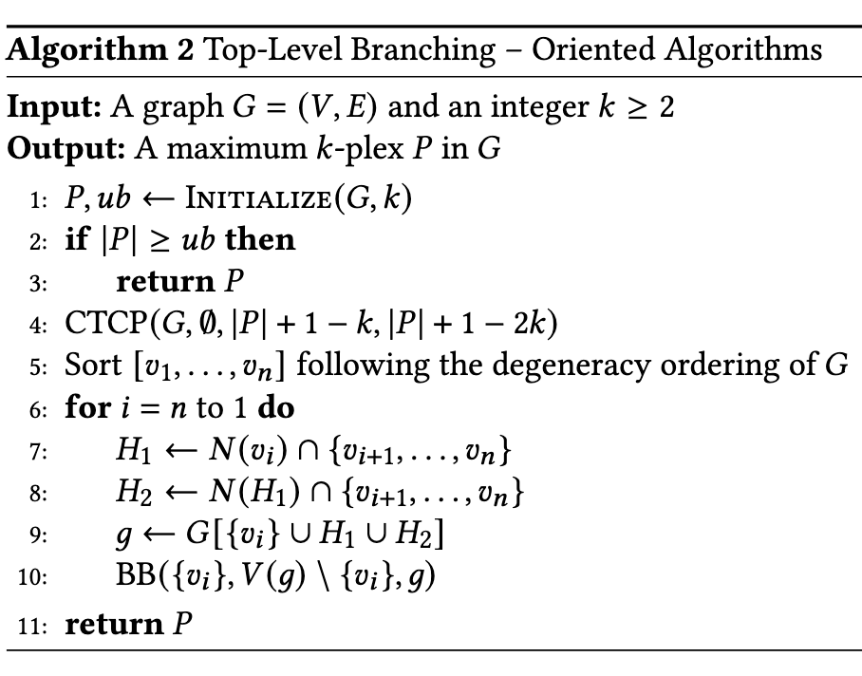
Oriented Algorithm
Algo code is in notes
Notes:
\begin{algorithmic}[1]
\State $P, ub \gets \textsc{Initialize}(G, k)$
\If{$|P| \geq ub$}\label{top:l2}
\State \Return $P$
\EndIf
\State $\textsc{CTCP}(G, \emptyset, |P|+1-k, |P|+1-2k)$\label{top:l3}
\State Sort $[v_1,\ldots,v_n]$ following the degeneracy ordering of $G$\label{top:l4}
\For{$i=n$ to $1$}\label{top:l5}
\State $H_1 \gets N(v_i) \cap \{v_{i+1},\ldots,v_n\}$\label{top:l6}
\State $H_2 \gets N(H_1) \cap \{v_{i+1},\ldots,v_n\}$\label{top:l7}
\State $g \gets G[\{v_i\} \cup H_1 \cup H_2]$\label{top:l8}
\State $\textsc{BB}(\{v_i\}, V(g) \setminus \{v_i\}, g)$
\EndFor
\State \Return $P$
\end{algorithmic}
\end{algorithm}

Slide 22




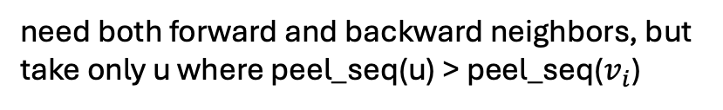



Oriented Algorithm
Degeneracy Order
$$v_{i}$$
sorted ascending
sorted descending
$$N\left(v_{i}\right)$$
forward neigh ↑
backward neigh ↓
only the forward neighbors of $v_{i}$
need both forward and backward neighbors, but take only u where peel_seq(u) > peel_seq($v_{i}$)
Algo code is in notes
Notes:
\begin{algorithmic}[1]
\State $P, ub \gets \textsc{Initialize}(G, k)$
\If{$|P| \geq ub$}\label{top:l2}
\State \Return $P$
\EndIf
\State $\textsc{CTCP}(G, \emptyset, |P|+1-k, |P|+1-2k)$\label{top:l3}
\State Sort $[v_1,\ldots,v_n]$ following the degeneracy ordering of $G$\label{top:l4}
\For{$i=n$ to $1$}\label{top:l5}
\State $H_1 \gets N(v_i) \cap \{v_{i+1},\ldots,v_n\}$\label{top:l6}
\State $H_2 \gets N(H_1) \cap \{v_{i+1},\ldots,v_n\}$\label{top:l7}
\State $g \gets G[\{v_i\} \cup H_1 \cup H_2]$\label{top:l8}
\State $\textsc{BB}(\{v_i\}, V(g) \setminus \{v_i\}, g)$
\EndFor
\State \Return $P$
\end{algorithmic}
\end{algorithm}

Slide 23
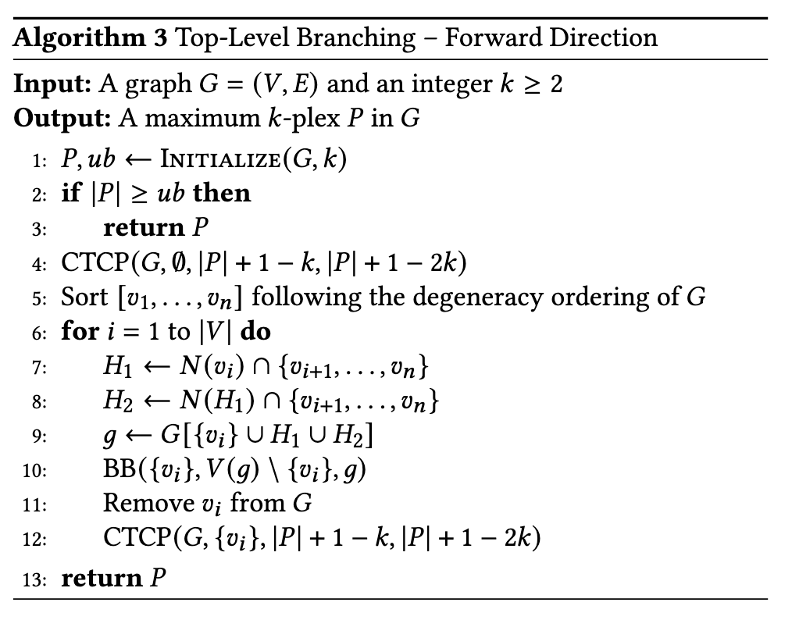
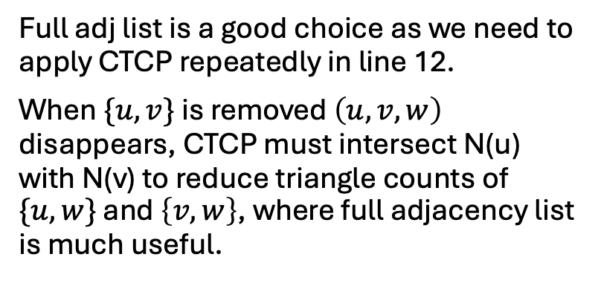
Why Full Adj List for Forward Direction?
Full adj list is a good choice as we need to apply CTCP repeatedly in line 12.
When $\{u,v\}$ is removed $\left(u,v,w\right)$ disappears, CTCP must intersect N(u) with N(v) to reduce triangle counts of $\{u,w\}$ and $\left\{v,w\right\}$, where full adjacency list is much useful.
u
v
w
Notes:
\begin{algorithmic}[1]
\State $P, ub \gets \textsc{Initialize}(G,k)$
\If{$|P| \geq ub$}\label{top-c2:l2}
\State \Return $P$
\EndIf
\State $\textsc{CTCP}(G, \emptyset, |P|+1-k, |P|+1-2k)$\label{top-c2:l3}
\State Sort $[v_1,\ldots,v_n]$ following the degeneracy ordering of $G$\label{top-c2:l4}
\For{$i=1$ to $|V|$}\label{top-c2:l5}
\State $H_1 \gets N(v_i) \cap \{v_{i+1},\ldots,v_n\}$\label{top-c2:l6}
\State $H_2 \gets N(H_1) \cap \{v_{i+1},\ldots,v_n\}$\label{top-c2:l7}
\State $g \gets G[\{v_i\} \cup H_1 \cup H_2]$\label{top-c2:l8}
\State $\textsc{BB}(\{v_i\}, V(g) \setminus \{v_i\}, g)$
\State Remove $v_i$ from $G$\label{top-c2:l10}
\State $\textsc{CTCP}(G, \{v_i\}, |P|+1-k, |P|+1-2k)$\label{top-c2:l11}
\EndFor
\State \Return $P$
\end{algorithmic}
\end{algorithm}

Slide 24
Scheme 1
One classifier, with classes being the 24 leaves
sparse
dense(always AltRB)
No-AltRB
AltRB
kPEX-oriented-B​
kPEX-oriented-S​
kPEX-oriented-R​
kPEX-oriented-P​
kPEX-B​
kPEX-S ​
kPEX-R ​
kPEX-P​
UMkP-oriented-B​
UMkP-oriented-S​
UMkP-oriented-R​
UMkP-oriented-P​
UMkP-B​
UMkP-S​
UMkP-R​
UMkP-P​
UMkP+-oriented-B​
UMkP+-oriented-S​
UMkP+-oriented-R​
UMkP+-oriented-P​
UMkP+-B​
UMkP+-S​
UMkP+-R​
UMkP+-P​

Slide 25
Scheme oriented first
forward
oriented
UMkP-B​
UMkP-S​
UMkP-R​
UMkP-P​
UMkP+-oriented-B​
UMkP+-oriented-S​
UMkP+-oriented-R​
UMkP+-oriented-P​
UMkP+-B​
UMkP+-S​
UMkP+-R​
UMkP+-P​
kPEX-oriented-B​
kPEX-oriented-S​
kPEX-oriented-R​
kPEX-oriented-P​
kPEX-B​
kPEX-S ​
kPEX-R ​
kPEX-P​
UMkP-oriented-B​
UMkP-oriented-S​
UMkP-oriented-R​
UMkP-oriented-P​

Slide 26
B-Branching First
forward
oriented
​
UMkP-S​
UMkP-R​
UMkP-P​
UMkP-B
UMkP+-B
kPEX-B
UMkP-oriented-B
UMkP+-oriented-B
kPEX-oriented-B
UMkP-oriented-S​
UMkP-oriented-R​
UMkP-oriented-P​
UMkP+-S​
UMkP+-R​
UMkP+-P​
UMkP+-oriented-S​
UMkP+-oriented-R​
UMkP+-oriented-P​
kPEX-S ​
kPEX-R ​
kPEX-P​
​kPEX-oriented-S​
kPEX-oriented-R​
kPEX-oriented-P​

Slide 27
Scheme 3
A hierarchy of classifiers
  3 classifiers
    shared ternary classifier
sparse
dense(always AltRB)
No-AltRB
AltRB
kPEX-oriented-B​
kPEX-oriented-S​
kPEX-oriented-R​
kPEX-oriented-P​
kPEX-B​
kPEX-S ​
kPEX-R ​
kPEX-P​
UMkP-oriented-B​
UMkP-oriented-S​
UMkP-oriented-R​
UMkP-oriented-P​
UMkP-B​
UMkP-S​
UMkP-R​
UMkP-P​
Stage 1: Sparse vs Dense
├── Dense → Stage 3
└── Sparse → Stage 2
├── AltRB → Stage 3
└── No-AltRB → Stage 3
Stage 3: Oriented vs Non-Oriented
├── Oriented → Stage 4
└── Non-Oriented → Stage 4
Stage 4: 4 classes
1. ...-S
2. ...-R
3. ...-P
4. ...-B
UMkP+-oriented-B​
UMkP+-oriented-S​
UMkP+-oriented-R​
UMkP+-oriented-P​
UMkP+-B​
UMkP+-S​
UMkP+-R​
UMkP+-P​

Slide 28
XGB Classifier Performance Metrics (On Entire dataset)
For 24 algorithms (Scheme 3) Stratified on Y and K
Stage | Samples | Accuracy | Precision | Recall
Stage 1 (Sparse vs Dense) | 4279 | 0.876607 | 0.88568 | 0.824323
Stage 2 (AltRB vs No-AltRB) | 2928 | 0.911202 | 0.909181 | 0.899138
Stage 3 (Dense Orientation) | 1351 | 0.840118 | 0.877559 | 0.799487
Stage 3 (Sparse-AltRB Orientation) | 1085 | 0.975115 | 0.969854 | 0.97069
Stage 3 (Sparse-NoAltRB Orientation) | 1843 | 0.971785 | 0.946268 | 0.922982
Stage 4 (B-S-R-P router) | 4279 | 0.811405 | 0.807905 | 0.791039
Final (End-to-End) | 4279 | 0.720262 | 0.70544 | 0.721853
Stage 1: Sparse vs Dense
├── Dense → Stage 3
└── Sparse → Stage 2
├── AltRB → Stage 3
└── No-AltRB → Stage 3
Stage 3: Oriented vs Non-Oriented
├── Oriented → Stage 4
└── Non-Oriented → Stage 4
Stage 4: 4 classes
1. ...-S
2. ...-R
3. ...-P
4. ...-B
Notes:
Currently, fallback acts as a low-confidence sentinel. If confidence is below τ, the classifier outputs a placeholder label. This placeholder must be replaced by a defined safe algorithm or abstention policy to make the system operationally complete.

Slide 29
RF Classifier Performance Metrics (On Entire dataset)
For 24 algorithms (Scheme 3) Stratified on Y and K
Stage | Samples | Accuracy | Precision | Recall
Stage 1 (Sparse vs Dense) | 4279 | 0.826829 | 0.800565 | 0.795525
Stage 2 (AltRB vs No-AltRB) | 2928 | 0.851776 | 0.85329 | 0.824639
Stage 3 (Dense Orientation) | 1351 | 0.80903 | 0.864722 | 0.757662
Stage 3 (Sparse-AltRB Orientation) | 1085 | 0.954839 | 0.940732 | 0.953579
Stage 3 (Sparse-NoAltRB Orientation) | 1843 | 0.938144 | 0.845252 | 0.901895
Stage 4 (B-S-R-P router) | 4279 | 0.59126 | 0.57024 | 0.585638
Final (End-to-End) | 4279 | 0.439822 | 0.422926 | 0.419311
Stage 1: Sparse vs Dense
├── Dense → Stage 3
└── Sparse → Stage 2
├── AltRB → Stage 3
└── No-AltRB → Stage 3
Stage 3: Oriented vs Non-Oriented
├── Oriented → Stage 4
└── Non-Oriented → Stage 4
Stage 4: 4 classes
1. ...-S
2. ...-R
3. ...-P
4. ...-B
Notes:
Currently, fallback acts as a low-confidence sentinel. If confidence is below τ, the classifier outputs a placeholder label. This placeholder must be replaced by a defined safe algorithm or abstention policy to make the system operationally complete.

Slide 30
Experiments
A classifier on oriented and forward did not help
We observed that binary branching is difficult to predict
forward
oriented
UMkP-B​
UMkP-S​
UMkP-R​
UMkP-P​
UMkP+-oriented-B​
UMkP+-oriented-S​
UMkP+-oriented-R​
UMkP+-oriented-P​
UMkP+-B​
UMkP+-S​
UMkP+-R​
UMkP+-P​
kPEX-oriented-B​
kPEX-oriented-S​
kPEX-oriented-R​
kPEX-oriented-P​
kPEX-B​
kPEX-S ​
kPEX-R ​
kPEX-P​
UMkP-oriented-B​
UMkP-oriented-S​
UMkP-oriented-R​
UMkP-oriented-P​

Slide 31
Next steps for classifcation
Binary introduced many wrong prediction, because previously the ML prediction was much better when we did not include kPlexT-Binary branching.
Now we are trying a classifier for binary branching, and another classifier for other 16 algorithms.
Try scheme 1 within the two branches
Binary
Others
UMkP-B
UMkP-oriented-B
kPEX-B ​
​kPEX-oriented-B
UMkP+-B​
UMkP+-oriented-B
​
kPEX-oriented-S​
kPEX-oriented-R​
kPEX-oriented-P​
UMkP+-oriented-S​
UMkP+-oriented-R​
UMkP+-oriented-P​
​
UMkP-oriented-S​
UMkP-oriented-R​
UMkP-oriented-P​
UMkP-S​
UMkP-R​
UMkP-P​
​
kPEX-S ​
kPEX-R ​
kPEX-P​
UMkP+-S​
UMkP+-R​
UMkP+-P​

Slide 32
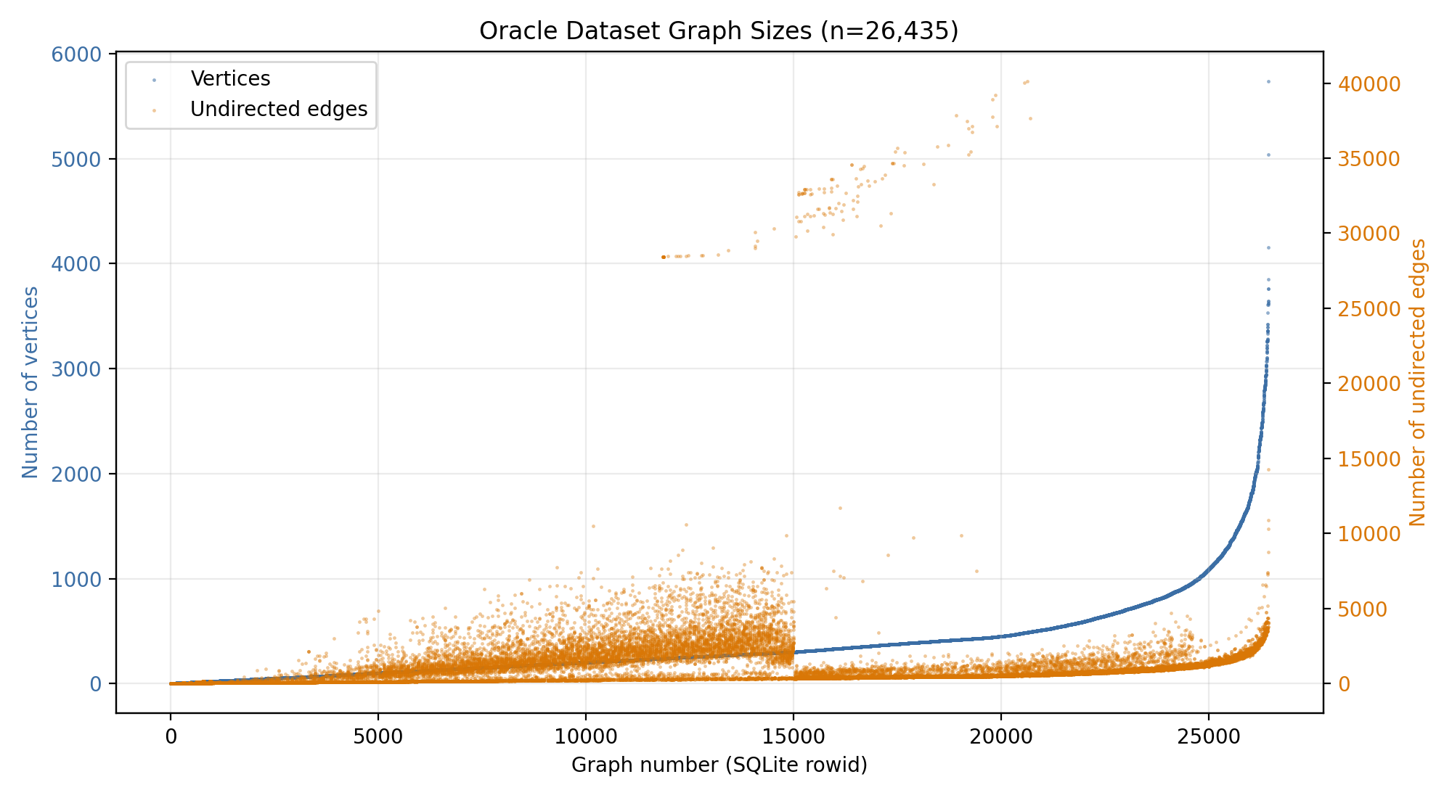
Oracle Dataset Characteristics

